Slide 1
Making Presentations That Audiences Will Love

Slide 2
Use a Template
Use a set font and color scheme.
Different styles are disconcerting to the audience.
You want the audience to focus on what you present, not the way you present.

Slide 3
Fonts
Choose a clean font that is easy to read.
Roman and Gothic typefaces are easier to read than Script or Comic.
Stick with one or two types of fonts.

Slide 4
Bullets
Keep each bullet to one line, two at the most.
Limit the number of bullets in a screen to six

Slide 5
Bullets & Cueing
Bullets allow you to “cue” the audience in on what you are going to say.
    Cues can be thought of as a brief “preview.”
    This gives the audience a “framework” to build upon.

Slide 6
Caps and Italics
Do not use all capital letters
  Makes text hard to read
  Conceals acronyms
  Denies their use for EMPHASIS
Italics
  Used for “quotes”
  Used to highlight thoughts or ideas
  Used for book, journal, or magazine titles

Slide 7
Colors
Reds and oranges are high-energy but can be difficult to stay focused on.
Greens, blues, and browns are mellower, but not as attention grabbing.

Slide 8
Backgrounds
A white on a dark background is used for this presentation as:
  The author assumes most users will view the presentation on their own computer.
  Having a darker background on a computer screen reduces glare.
  White on dark background should not be used if the audience is more than 20 feet away.

Slide 9
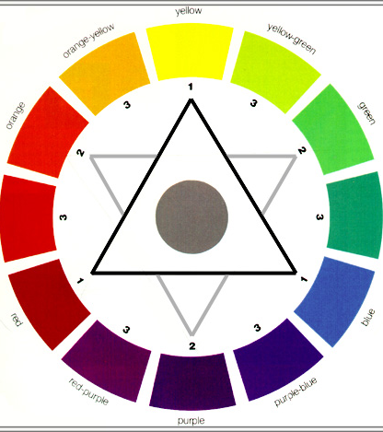
The Color Wheel
Colors separated by another color are contrasting colors (also known as complementary)
Adjacent colors (next to each other) harmonize with one another. e.g. Green and Yellow

Slide 10
Attention Grabber
To make a slide stand out, change the font and/or background

Slide 11
Illustrations
Use only when needed, otherwise they become distracters instead of communicators
They should relate to the message and help make a point
Ask yourself if it makes the message clearer
Simple diagrams are great communicators

Slide 12
Flipcharts
Make letters at least a 1/4 high
Flipcharts with lines are much easier to write on

Slide 13
Screen Size for Readability
Screen 6’ 8’ 10’ 12’ 15’
1/4 inch 30’ 40’ 50’ 60’ 90’
3/8 inch 45’ 60’ 75’ 90’ 135’
1/2 inch 60’ 80’ 100’ 120’ 180’
Examples
1/4” type shown on a screen size of 6’ can be seen 30’ away (20 point Times Roman equals 1/4” type)
1/2” type shown on a 10’ screen can be seen 75’ away (40 point Times Roman equals 1/4” type)

Slide 14
YOU
Do not use the media to hide you
The audience came to see you
The media should enhance the presentation, not BE the presentation
If all you are going to do is read from the slides or overheads, then just send them the slides
Remember, only you can prevent
“Death by PowerPoint”

Slide 15
Presentations by Donald R. Clark
FOR MORE INFORMATION
http://www.nwlink.com/~donclark/leader/leadpres.html
http://www.nwlink.com/~donclark/hrd/templates/presentation.rtf
donclark@nwlink.com

